Slide 1
Cisco Training by ICC
Session 3 :
Router Configuration

Slide 2
Why We Need Routing ????

Slide 3
Whenever we want two different subnets to communicate , we have to use a router in the middle

Slide 4
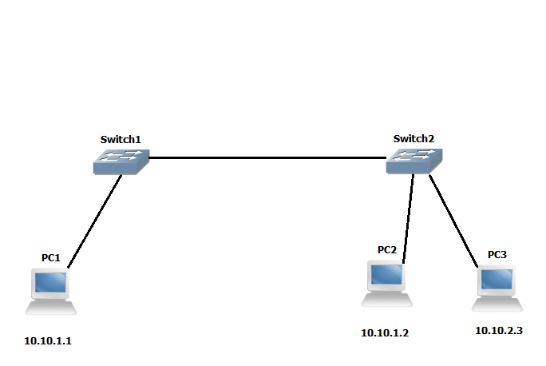

Slide 5
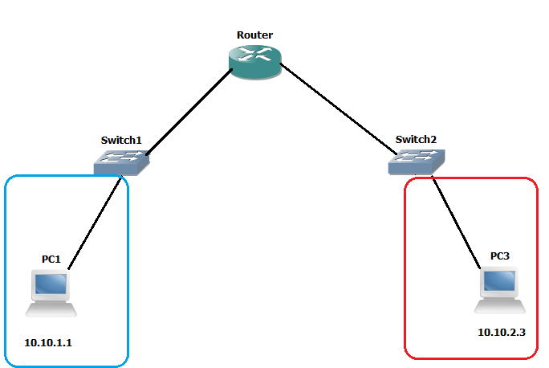

Slide 6
Why PC1 and PC3 are in different subnets ??

Slide 7
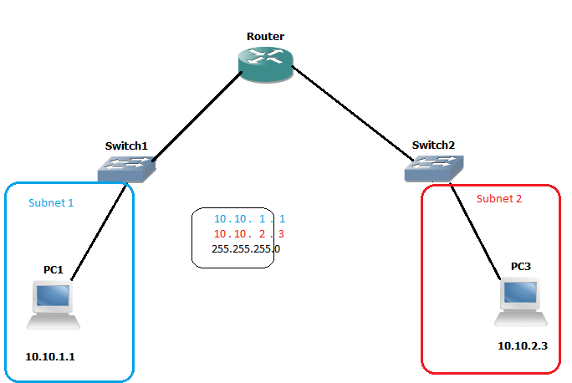

Slide 8
Each interface of router should have an IP address , in the same range of the subnet that is directly connected to it.

Slide 9
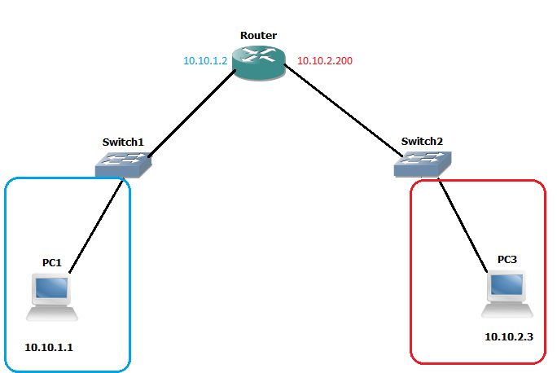

Slide 10
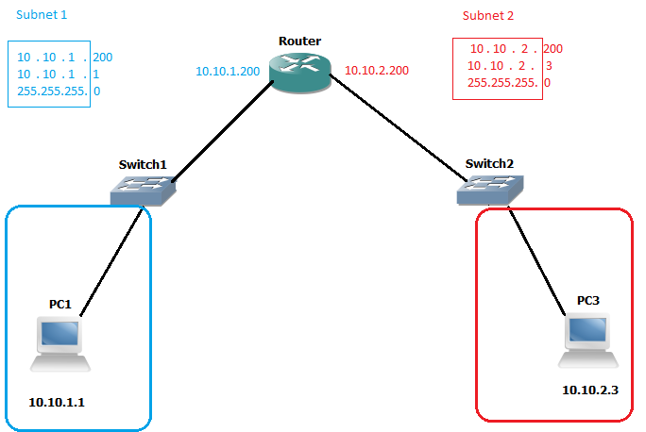

Slide 11
Router’s interfaces always should be in different subnets !!!

Slide 12
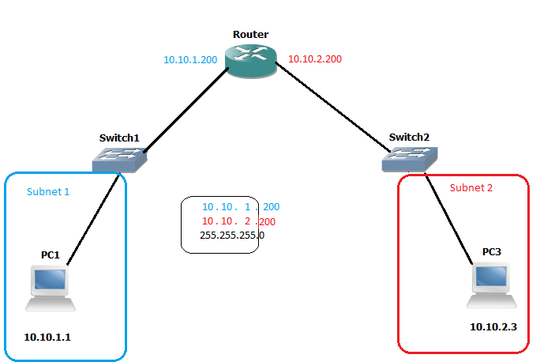

Slide 13
We should assign a Default Gateway IP to each PC in order to communicate successfully .
The Default Gateway should be the IP of Router’s interface .

Slide 14
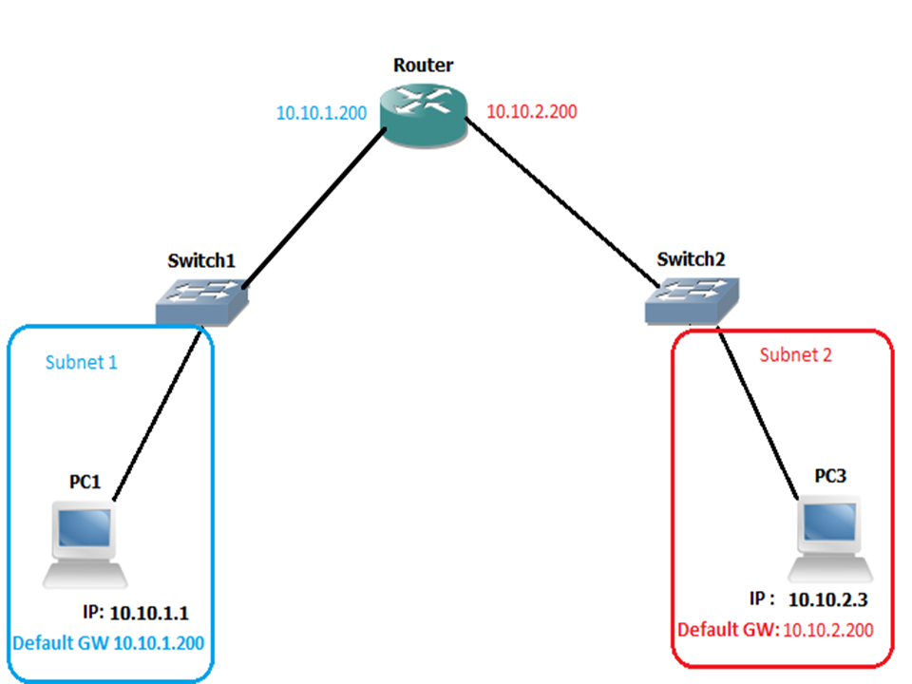

Slide 15
Router Configuration files
To view Router’s configuration file we use :
router# show running-config
To save the configuration on router we use :
router# write

Slide 16
Configure Hostname
router(config)# hostname Ahfad_router

Slide 17
Router Interface
To show all interfaces in the Router, and verify its status , and the assigned IP we use:
Router# show ip interface brief

Slide 18
Configure Interfaces IP
Router’s interface is by default down so we have to bring it up manually .
Router(config)# interface fa0/1
Router(config-if)# ip address 10.10.1.200 255.255.255.0
Router(config-if)# no shutdown

Slide 19
Configure Enable Password
We have two type for enable passowrd
1- unencrypted :
Router(config)# enable password cisco
2- encrypted :
Router(config)# enable secret cisco

Slide 20
Configure Telnet password
Router(config)# line vty 0 4
Router(config-line)#password cisco
Router(config-line)#login

Slide 21
Configure console password
Router(config)# line con 0
Router(config-line)#password cisco
Router(config-line)#login

Slide 22
End …

